Slide 1
Scratch
Flappy Bird – Part 2
Creating an infinite scrolling background and scoring system

Slide 2
Remember the Scratch URL
Our URL to find our workspace:
www.scratch.mit.edu

Slide 3
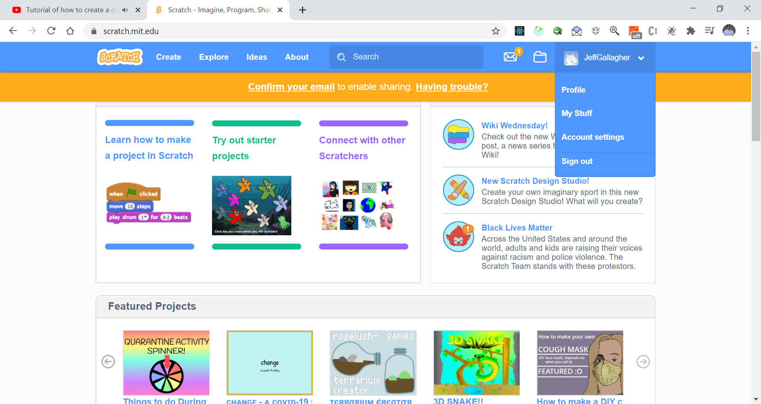
Retrieve your project – where to find it
My Stuff

Slide 4
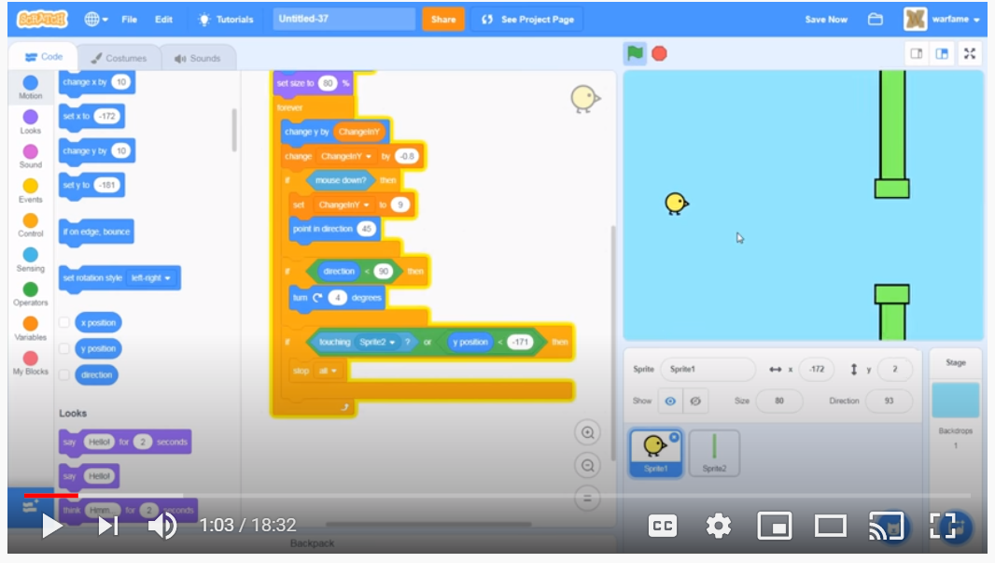
Make the bird lose when he goes to the bottom of the system
Insert If condition

Slide 5
Test your work
Verify if the bird goes to the bottom that the game stops.
What happens?

Slide 6
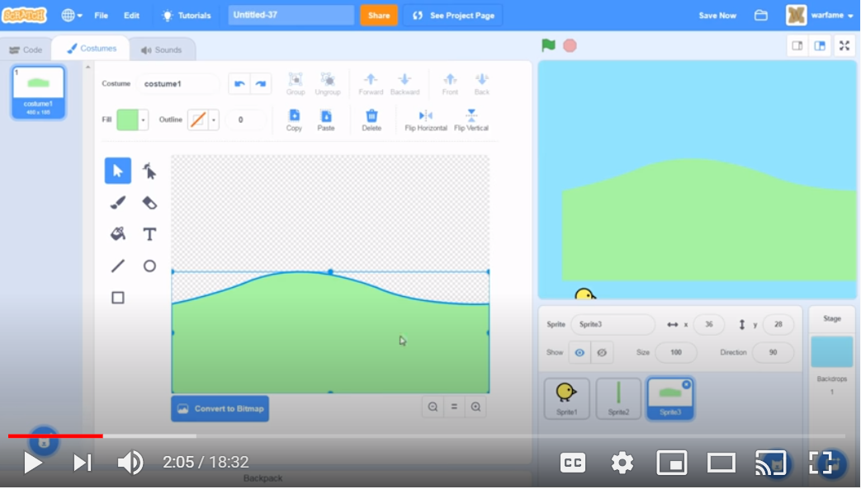
Create the scrolling back ground Add a new sprite and makes some hills

Slide 7
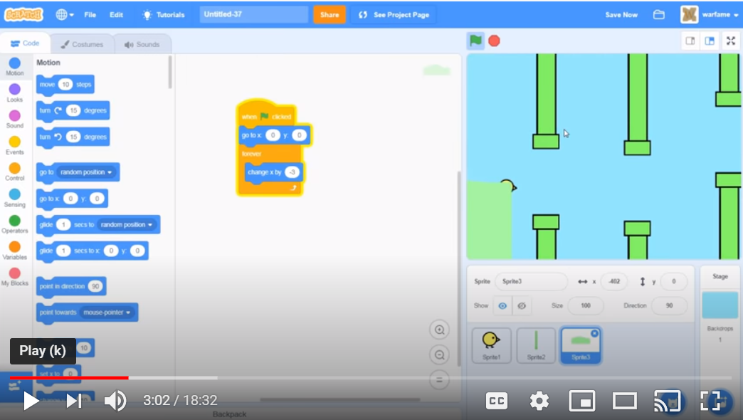
Code the hills – hills need to move to left

Slide 8
Test your work
Note the hills and pipes will be together for now. We will take care of that soon.
Do the hills scroll to the left?

Slide 9
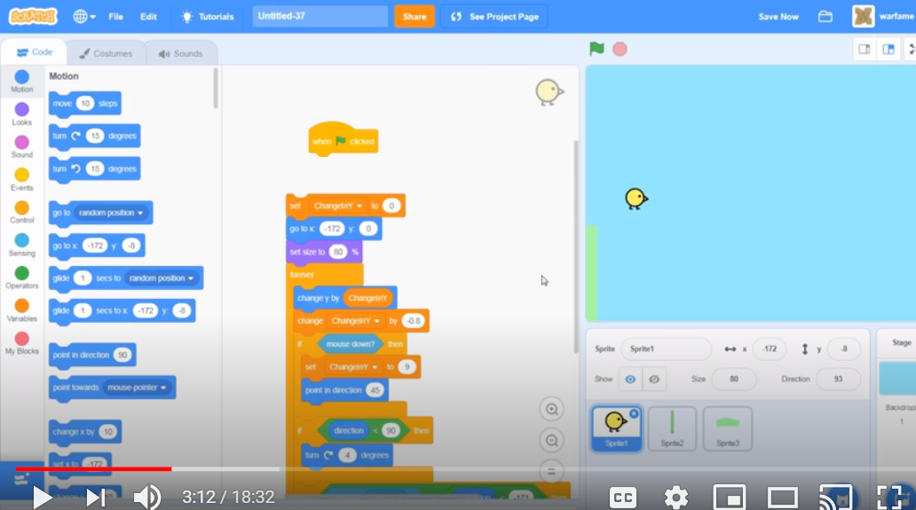
For testing disconnect code - chicken

Slide 10
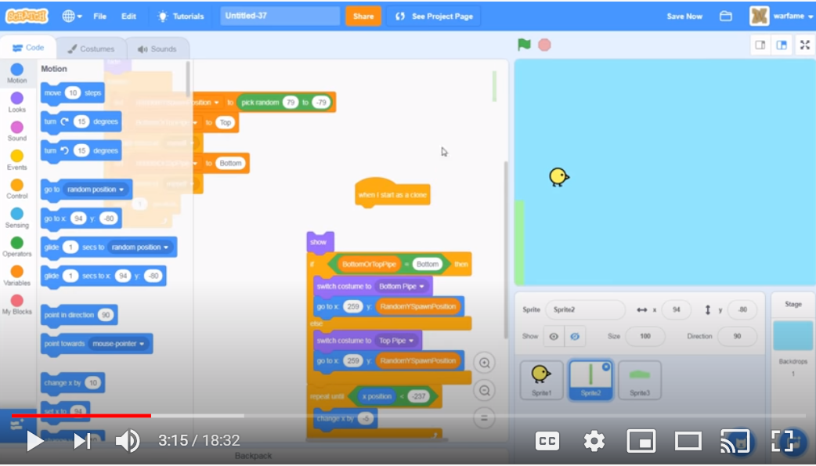
For testing disconnect code - pipe

Slide 11
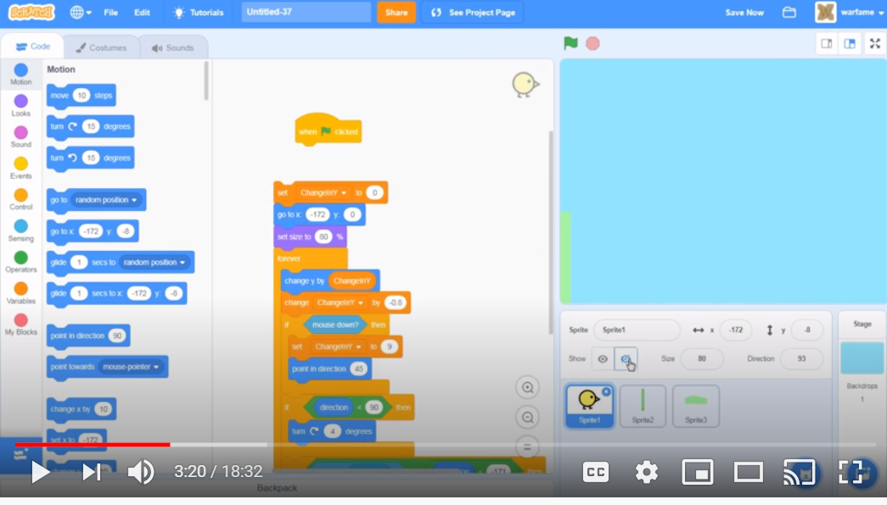
For testing – hide the chicken

Slide 12
Test – only the hill should exist
Now we want the hill to go to left edge from the right edge of the screen.

Slide 13
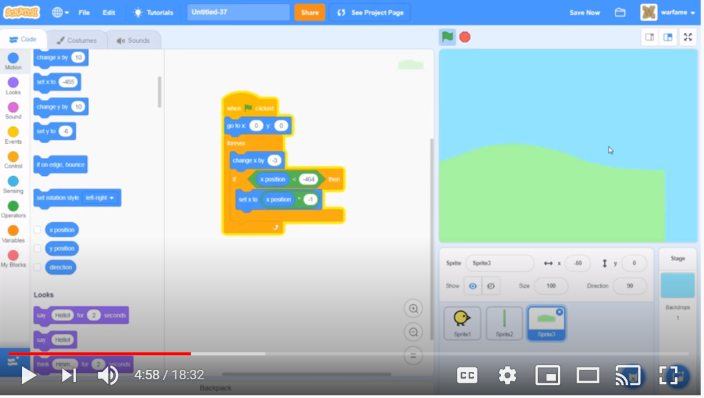
Code the scrolling landscape / hills Note -464 is the smallest/lowest position of the hills.

Slide 14
Test your work
Does it scroll
(there should be a gap, we will fix that)

Slide 15
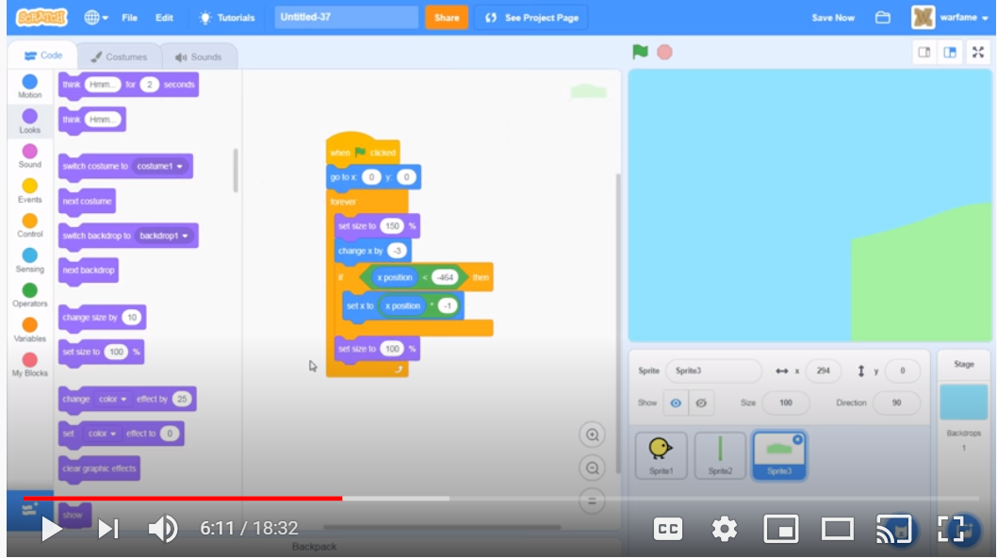
Fix the scroll

Slide 16
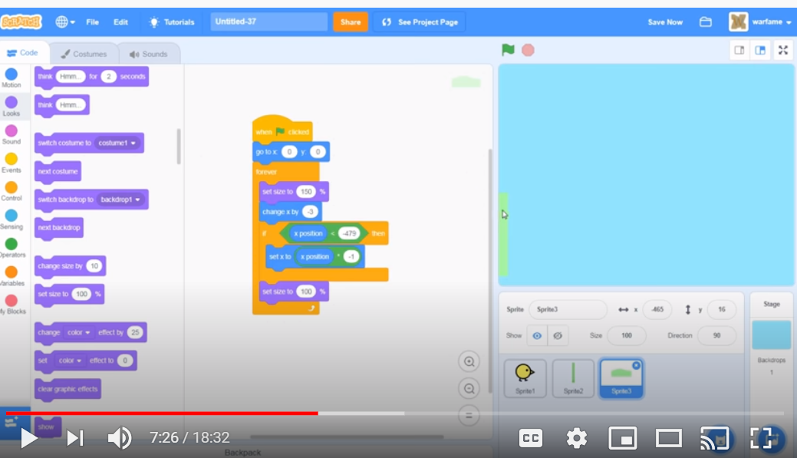
Change size

Slide 17
Test your work
What happens?
Is scrolling correct?

Slide 18
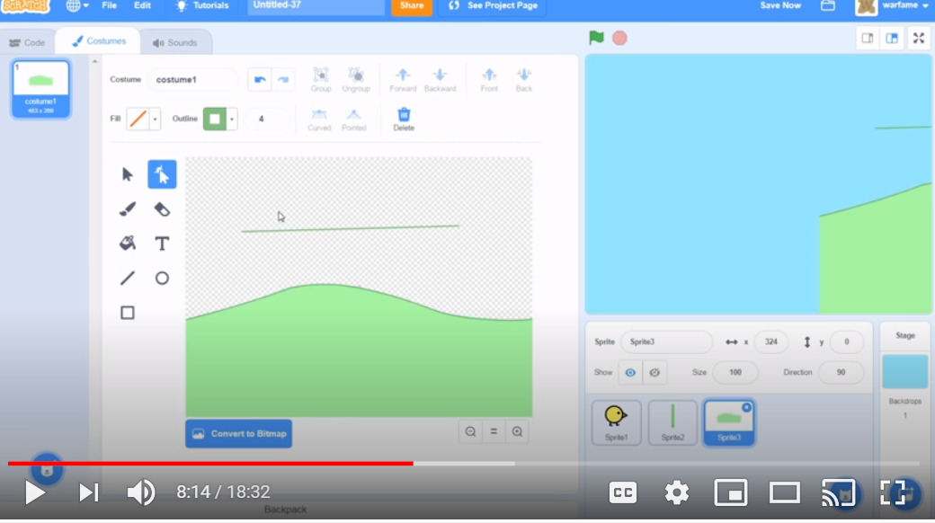
Add an outline to the hills for contrast

Slide 19
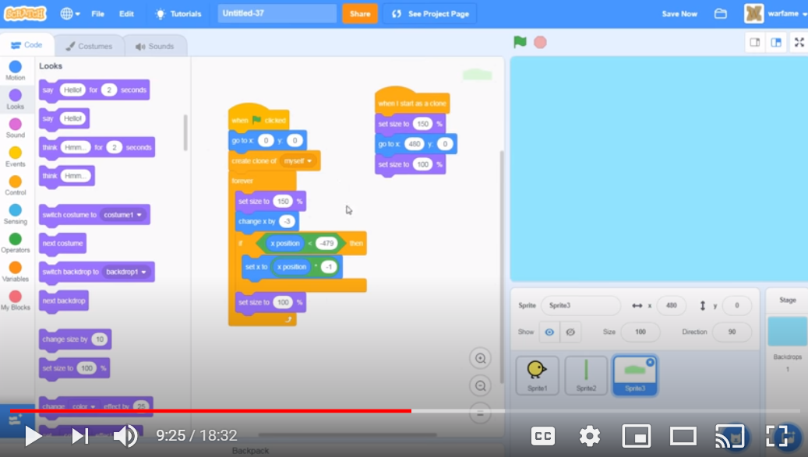
Add a second hill to fix the gap - clone

Slide 20
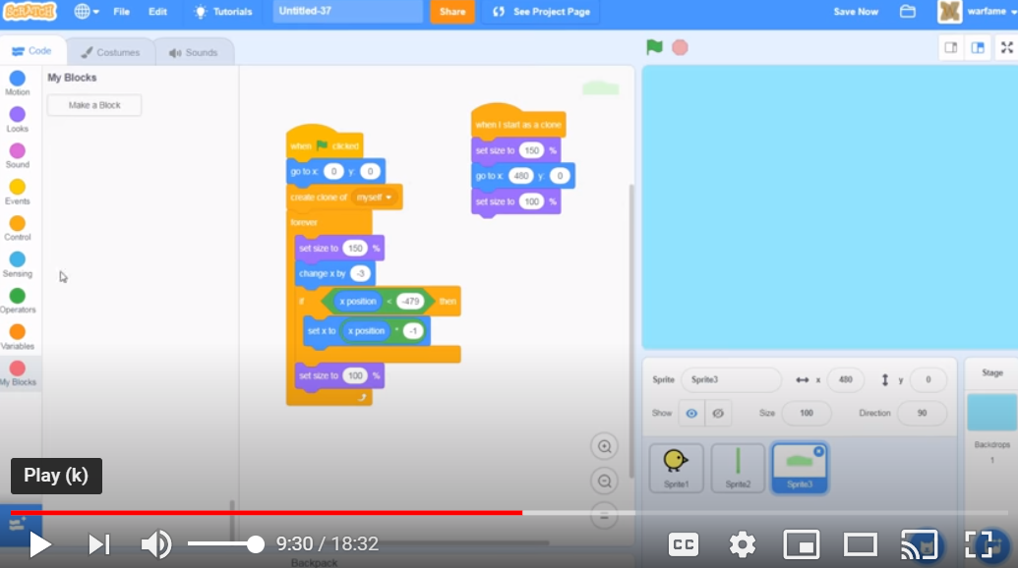
Create a code block – make a block Call it “Move”

Slide 21
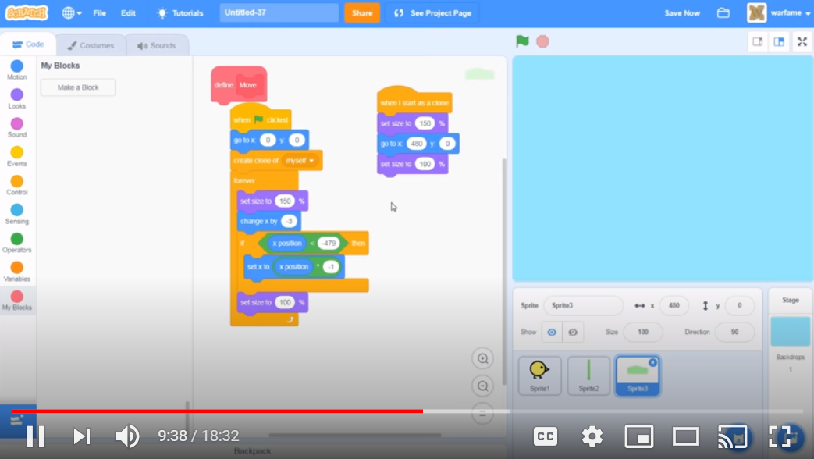
Code should look like this:

Slide 22
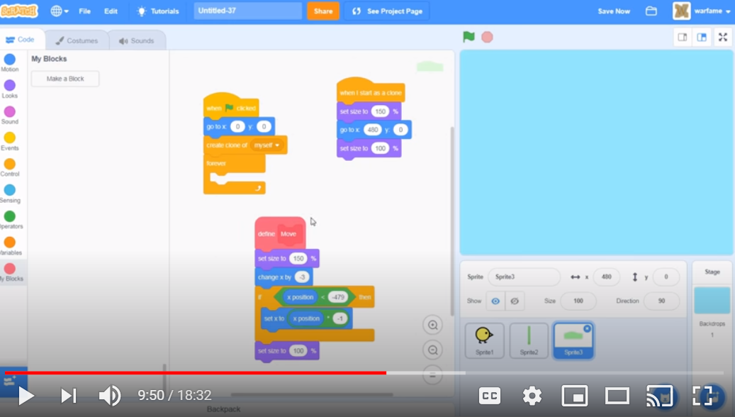
Organize your code with the block:

Slide 23
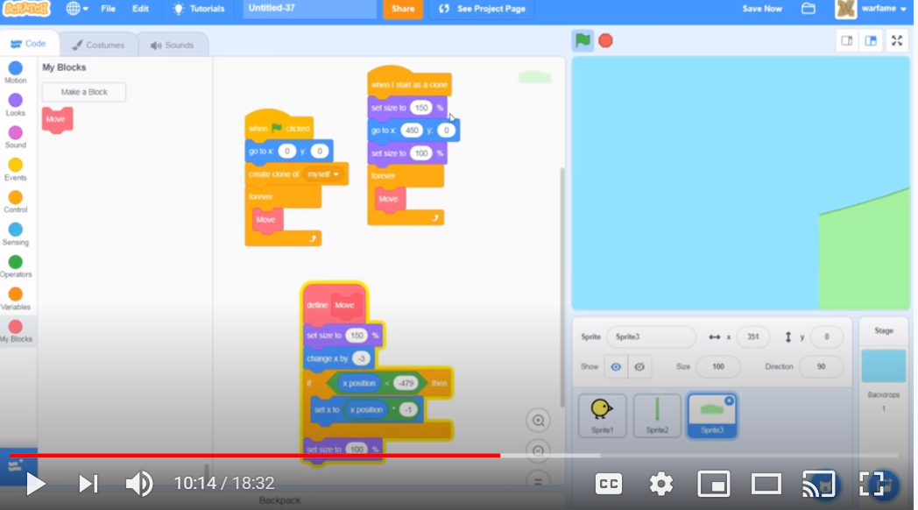
Continue to implement block:

Slide 24
Note code is easier to maintain
Allows for reuse and efficiency

Slide 25
Test your work – is there a scroll and no gap
What are your results?

Slide 26
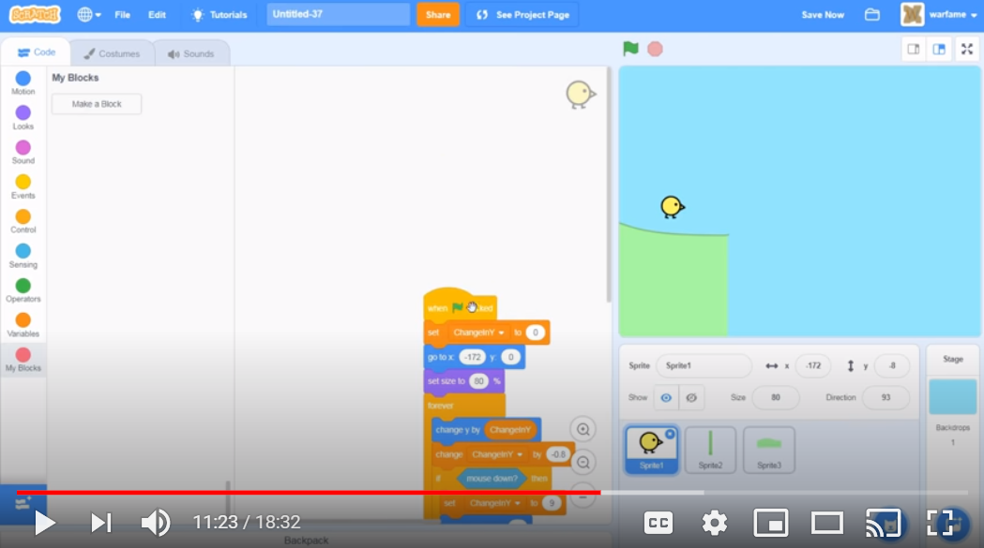
Add chicken back – also reconnect block

Slide 27
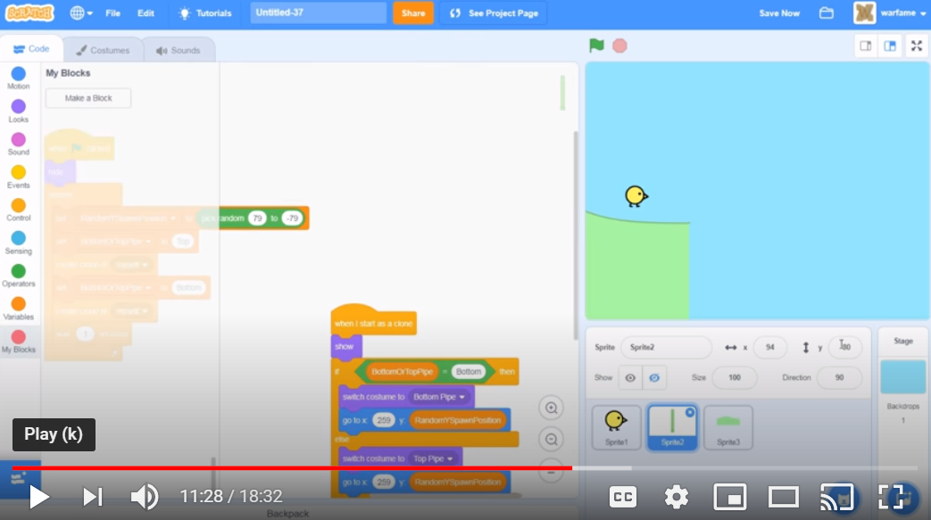
Add back pipe

Slide 28
Test the code
Let’s move the pipes in front of the hills

Slide 29
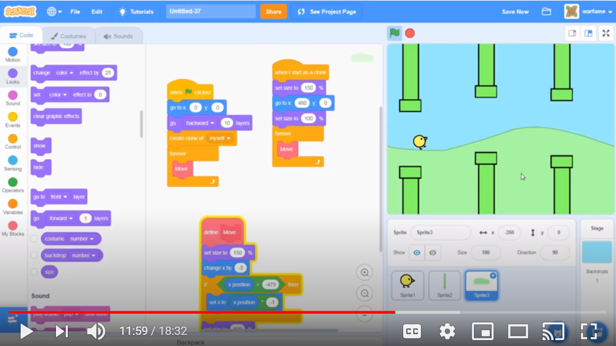
Make the following code change:

Slide 30
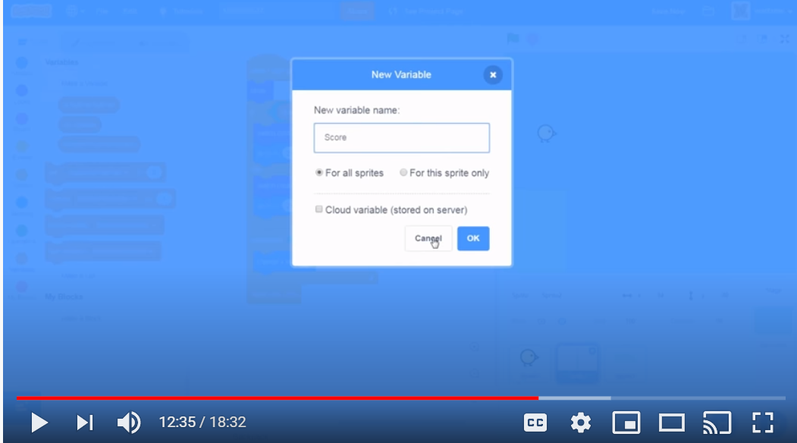
Let’s make a simple scoring system Go to pipes Create a variable

Slide 31
Scoring Rule
If the bird goes past the middle of the pipe, increase score by +1.

Slide 32
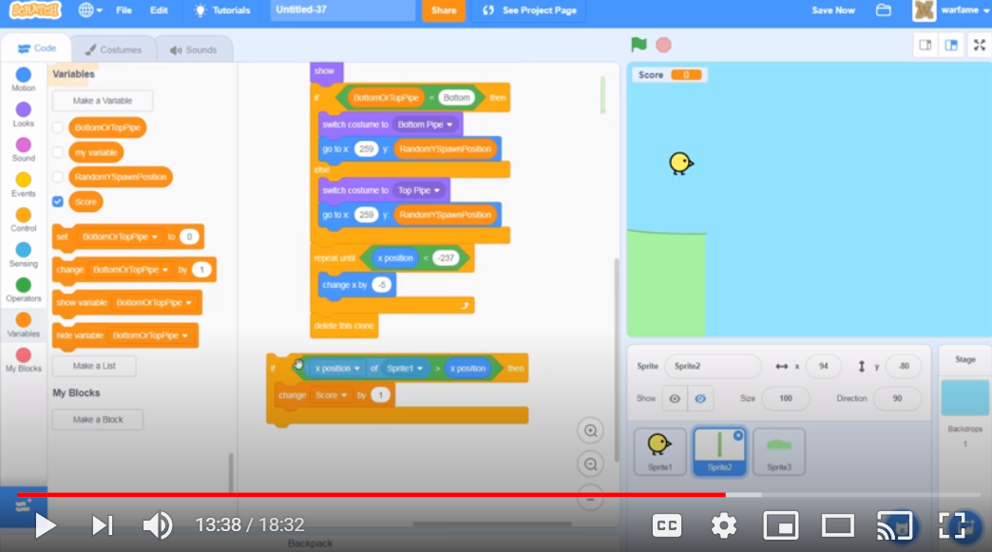
Add the following code:

Slide 33
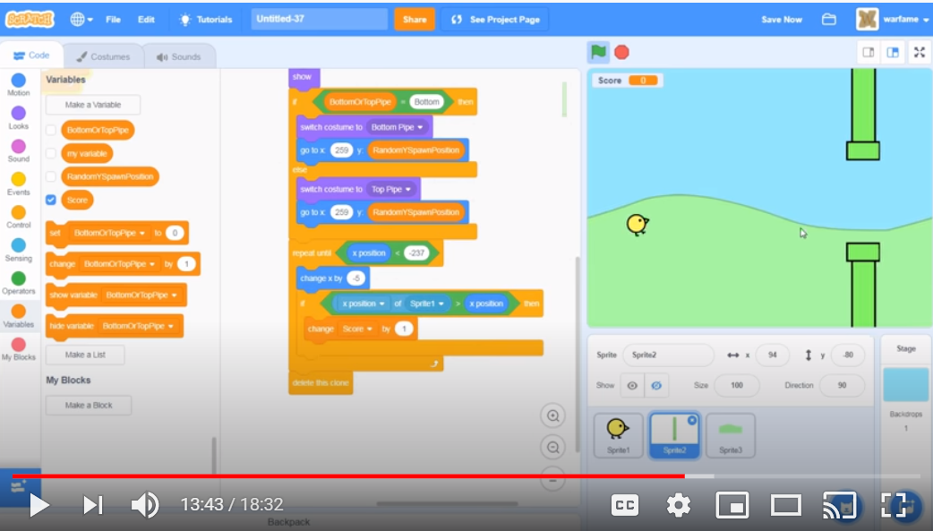
Add code to repeat until

Slide 34
Test your work
Is there is a problem with scoring?
When the bird is past the pipes the score goes up, we need to fix this.
Let’s fix this.

Slide 35
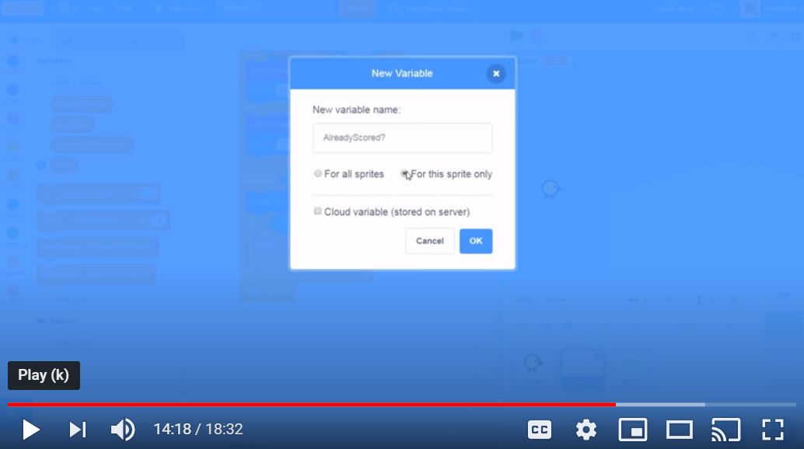
Create another variable (Pipe)

Slide 36
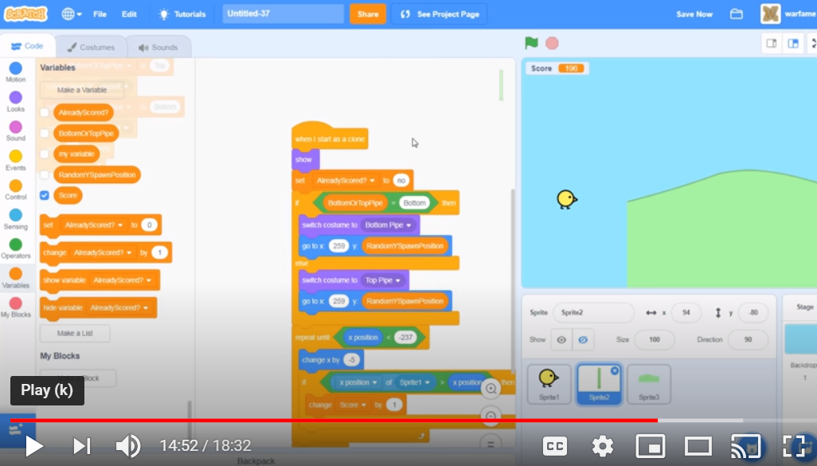
Initialize your new variable:

Slide 37
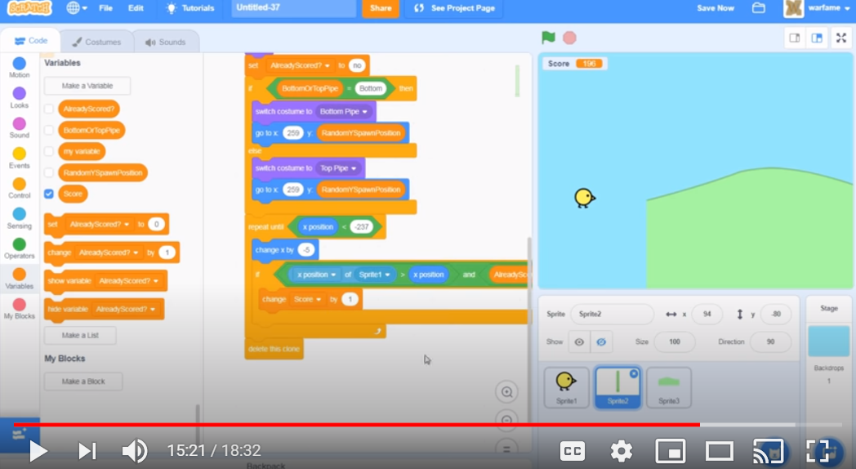
Modify you if condition

Slide 38
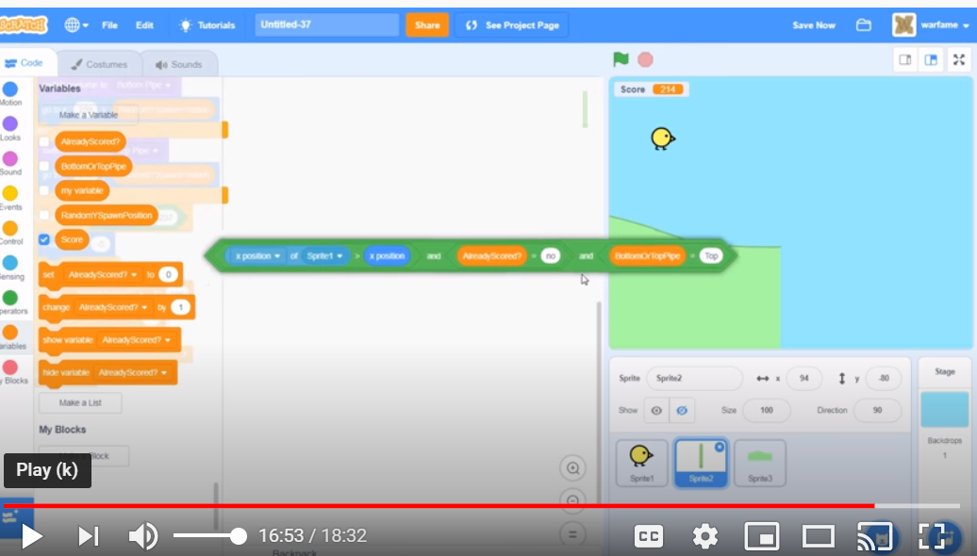
Code should look like this:

Slide 39
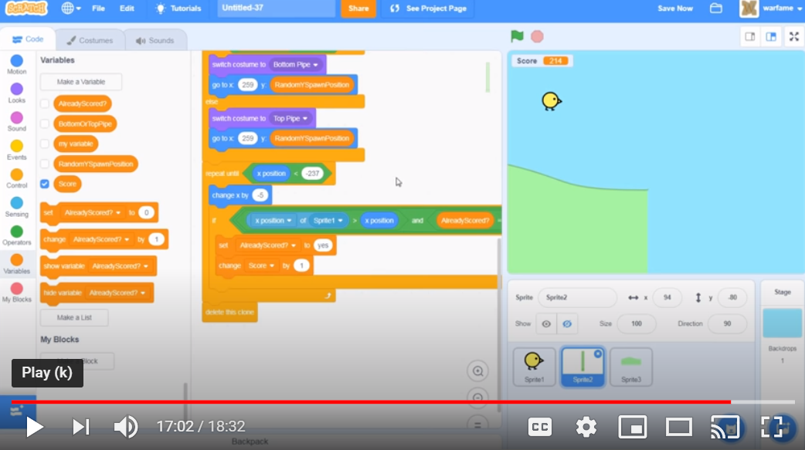
Another view:

Slide 40
Test – Set Score to 0
Does the scoring work? Does it increment by 1?
What can we do to improve?

Slide 41
Let’s stop here and continue next week
Questions?

